Slide 1


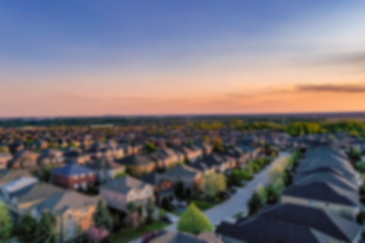


HOME
MARKETPLACE
EVENTS
CONTACT US
JOIN US
GRAND RIVERSIDE SUBDIVISION
COMMUNITY ORGANIZATIONS

Slide 2
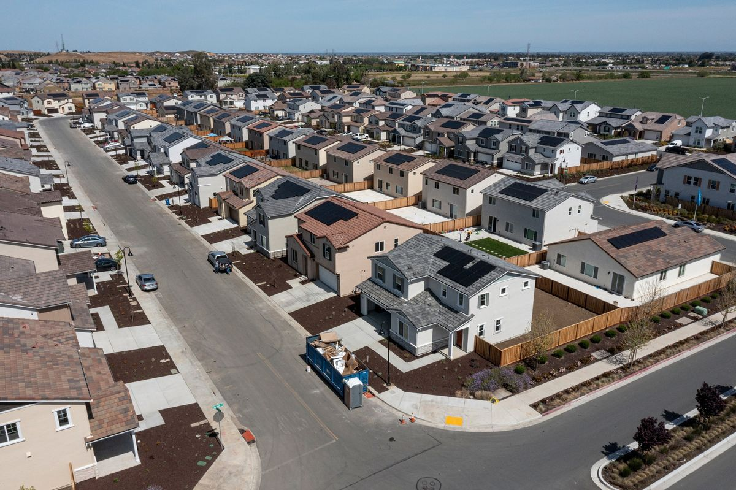
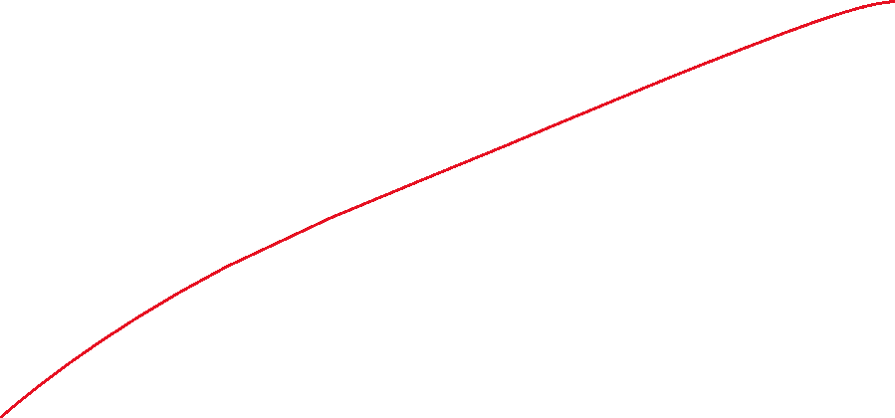

HOME
MARKETPLACE
EVENTS
CONTACT US
JOIN US
ABOUT US
Welcome to Grand Riverside Subdivision
A place unlike any other. Located In General Trias Cavite, this place is different than any community you have ever experienced... the first of its kind in the area. A place where the streets are lined with trees, the porches are made for interaction, and the neighborhoods are unique and have a rhythm all their own. A place that celebrates wide-open spaces and the beauty of the land. A place where living life in perfect harmony truly does come easy.
…

Slide 3

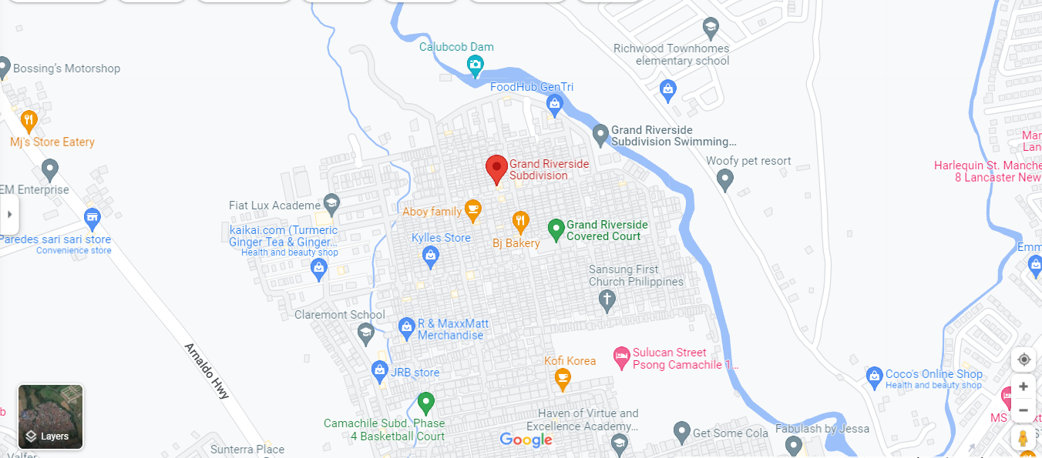




HOME
MARKETPLACE
EVENTS
CONTACT US
JOIN US
OUR LOCATION- GET DIRECTION
Pascam 1, General Trias Cavite
09234526253
2234-4556

Slide 4


HOME
MARKETPLACE
EVENTS
CONTACT US
JOIN US
GRAND RIVERSIDE SUBDIVISION
COMMUNITY ORGANIZATIONS

Slide 5



HOME
MARKETPLACE
EVENTS
CONTACT US
JOIN US
We’re introducing a marketplace, a convenient destination to discover, buy and sell items with people in your community. The marketplace makes it easy to find new things you’ll love, and find a new home for the things you’re ready to part with. We’ll continue to build new options and features to make this the best experience for people.
Marketplace

Slide 6
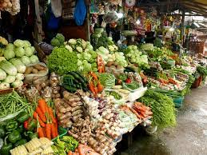

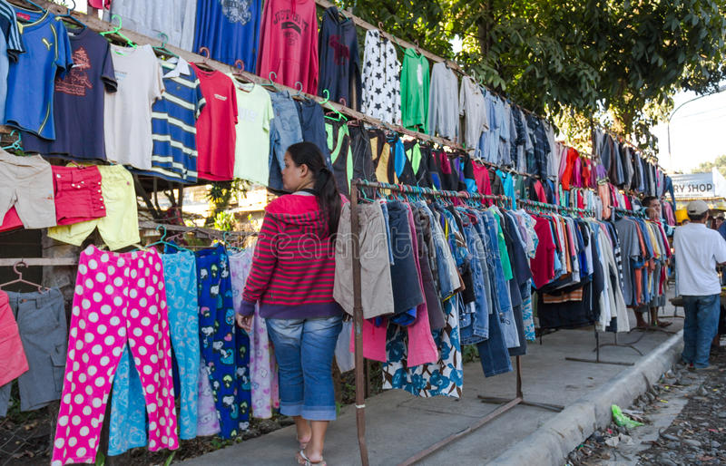
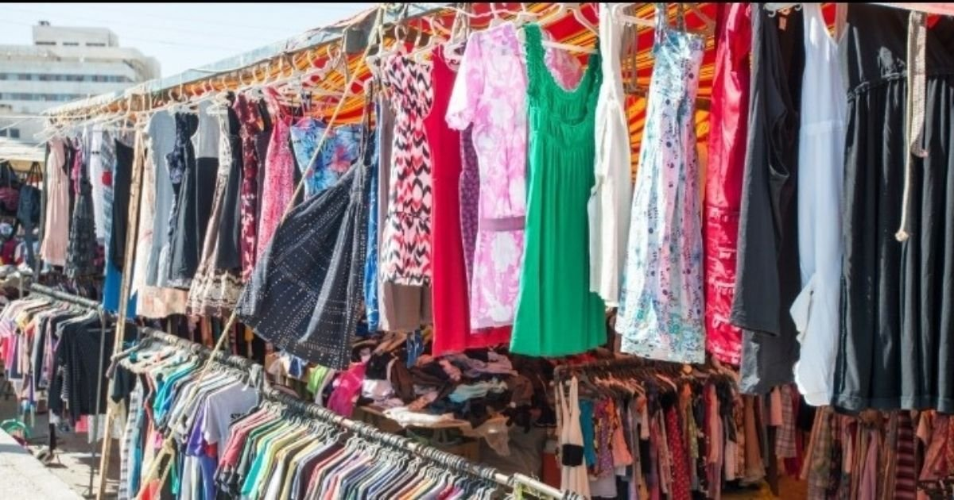
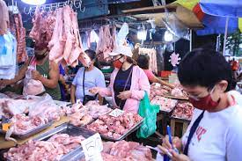

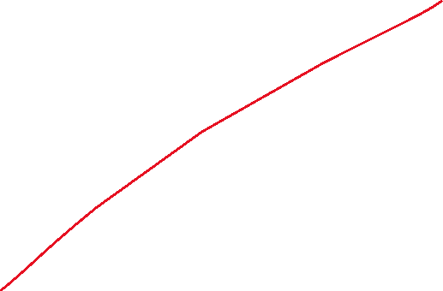

HOME
MARKETPLACE
EVENTS
CONTACT US
JOIN US
ITEMS OF CLOTHING
FOODS

Slide 7
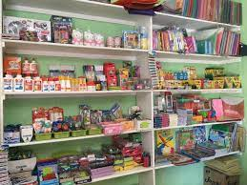
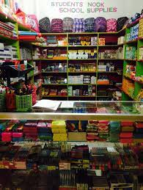

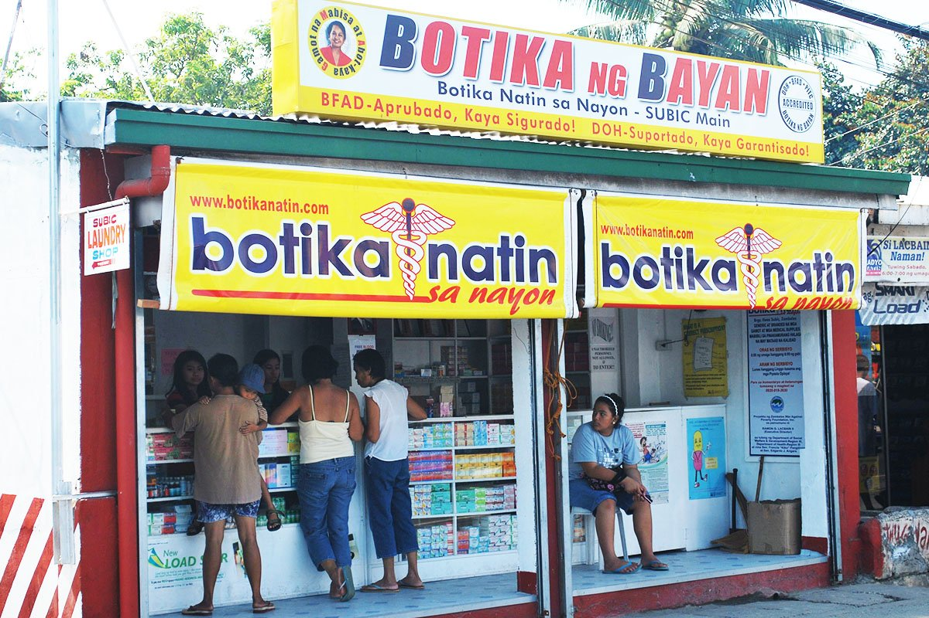
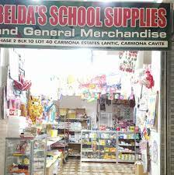


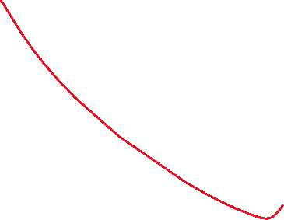
HOME
MARKETPLACE
EVENTS
CONTACT US
JOIN US
SCHOOL SUPPLIES
PHARMACY

Slide 8


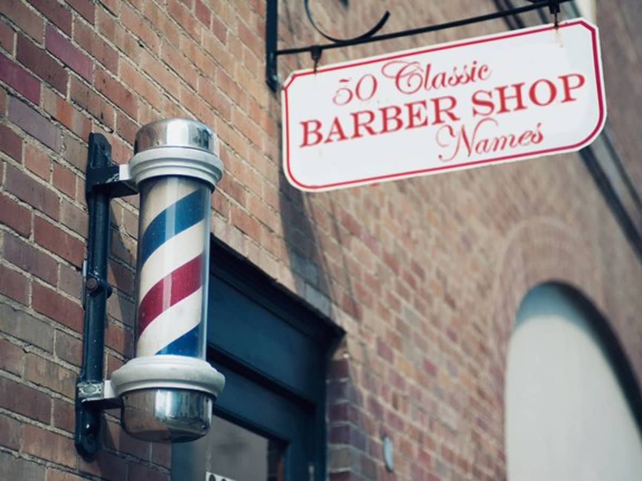

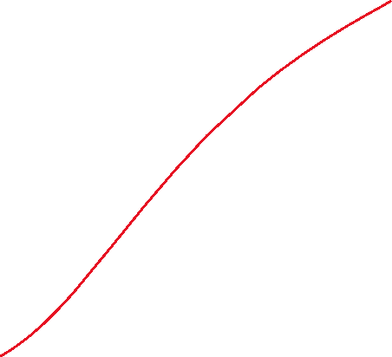
HOME
MARKETPLACE
EVENTS
CONTACT US
JOIN US
SALON/BARBER SHOP

Slide 9
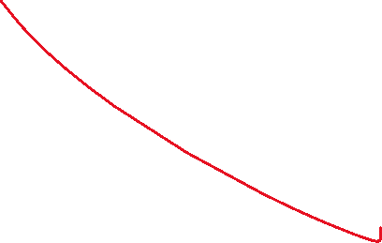

HOME
MARKETPLACE
EVENTS
CONTACT US
JOIN US
GRAND RIVERSIDE SUBDIVISION
COMMUNITY ORGANIZATIONS

Slide 10
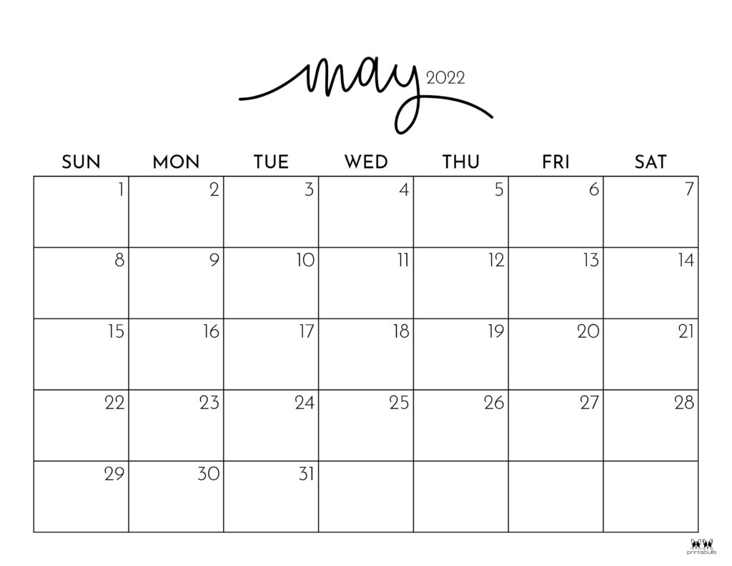

HOME
MARKETPLACE
EVENTS
CONTACT US
JOIN US
CALENDAR
UPCOMING EVENTS
HOA MEETING
LIGA BASKETBALL

Slide 11

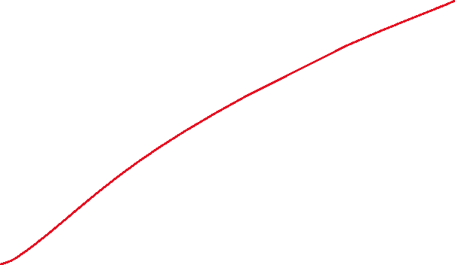
HOME
MARKETPLACE
EVENTS
CONTACT US
JOIN US
GRAND RIVERSIDE SUBDIVISION
COMMUNITY ORGANIZATIONS

Slide 12




HOME
MARKETPLACE
EVENTS
CONTACT US
JOIN US
CONTACT US
Name
Contact Number
Email Address
Message
SUBMIT

Slide 13


HOME
MARKETPLACE
EVENTS
CONTACT US
JOIN US
GRAND RIVERSIDE SUBDIVISION
COMMUNITY ORGANIZATIONS

Slide 14


HOME
MARKETPLACE
EVENTS
CONTACT US
JOIN US
Email Address
Password
SUBMIT
Forgot your password?
CREATE NEW ACCOUNT

Slide 15


HOME
MARKETPLACE
EVENTS
CONTACT US
JOIN US
Forgot Password
Please enter your e-mail below to reset your password.
Email Address
SUBMIT
Cancel

Slide 16
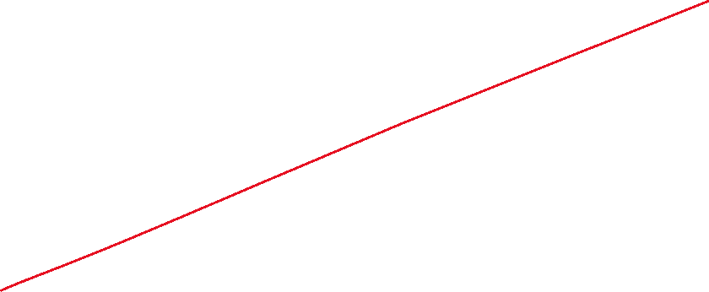

HOME
MARKETPLACE
EVENTS
CONTACT US
JOIN US
Create your Account
House Owner’s Name
Name of representative
Contact Number
Email address
Password
Re-type password
Date of birth?
Month
Day
Year
SUBMIT

Slide 17









GRAND RIVERSIDE SUBDIVISION
My profile
Create your post
Organizations
CCTV
Juan Manalo
Rules and Regulations
Apr 28 at 12 am
Someone lost his bike at 5 pm
Log out

Slide 18






GRAND RIVERSIDE SUBDIVISION
My profile
Create your post
NOTIFICATIONS
Organizations
CCTV
Anna Palma posted in KILAY
Rules and Regulations
2 new events added in HOA
Julian Carlo posted in SAMAHAN NG MGA KABATAAN
There are new posts in KILAY
Log out

Slide 19





GRAND RIVERSIDE SUBDIVISION
My profile
Create your post
NOTIFICATIONS
Organizations
CCTV
Categories
Rules and Regulations
Foods
Items of clothing
School Supplies
Pharmacy
Salon/Barbershop
Log out

Slide 20

GRAND RIVERSIDE SUBDIVISION
My profile
Organizations
Juan Manalo
CCTV
Rules and Regulations
Log out

Slide 21

COMMUNITY ORGANIZATIONS

Slide 22
Email Address
Password
SUBMIT
Forgot your password?
CREATE NEW ACCOUNT

Slide 23


GRAND RIVERSIDE SUBDIVISION
Create your post
My profile
Organizations
HOA
Juan Manalo
Apr 28 at 12 am
CCTV
KILAY
Someone lost his bike at 5 pm
Rules and Regulations
SAMAHAN NG MGA KABATAAN
Log out

Slide 24
GRAND RIVERSIDE SUBDIVISION
Create your post
My profile
Organizations
HOA
Juan Manalo
Apr 28 at 12 am
CCTV
KILAY
Someone lost his bike at 5 pm
Rules and Regulations
Join
Cancel
SAMAHAN NG MGA KABATAAN
Log out

Slide 25

KILAY
Private group 71.4K likes
MEMBERS/OFFICERS
NEWSFEED
ABOUT
EVENTS
PAYMENTS
Create your post
Log out

Slide 26
KILAY
Private group 71.4K likes
MEMBERS/OFFICERS
NEWSFEED
ABOUT
EVENTS
PAYMENTS
ABOUT US
A woman's Organization in Grand Riverside Subd. Pascam I
Log out

Slide 27
KILAY
Private group 71.4K likes
MEMBERS/OFFICERS
NEWSFEED
ABOUT
EVENTS
PAYMENTS
UPCOMING EVENTS
Log out

Slide 28
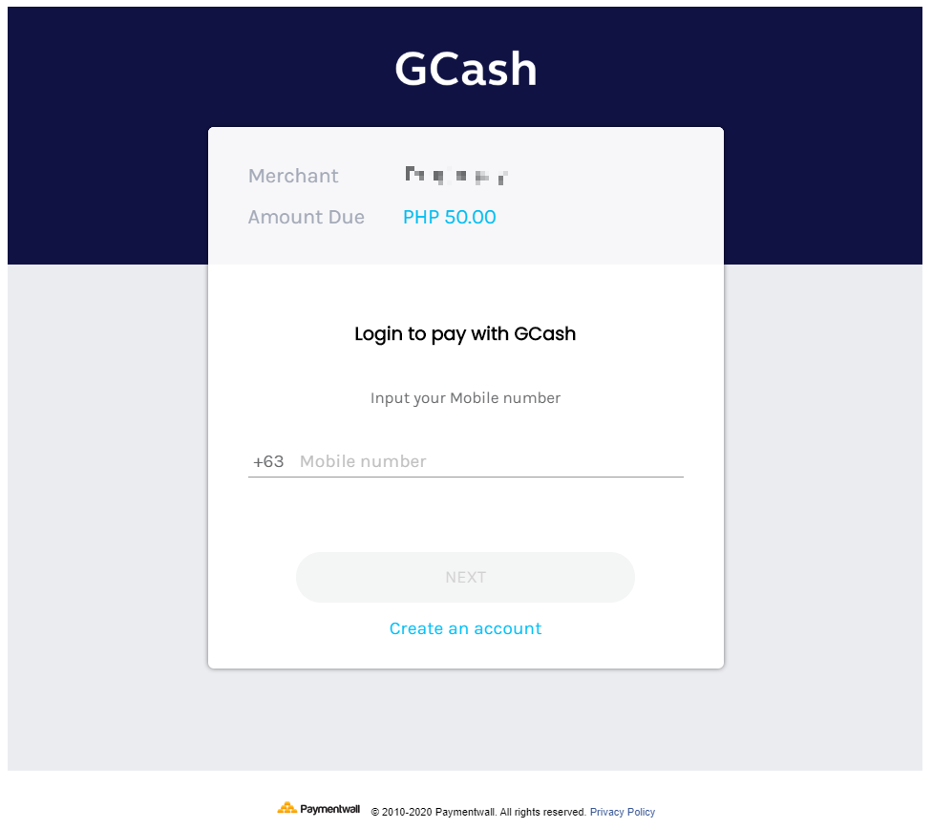
Log out

Slide 29
KILAY
Private group 71.4K likes
OFFICERS
NEWSFEED
ABOUT
EVENTS
PAYMENTS
KILAY OFFICERS
PRESIDENT
LENY TANA
VICE PRESIDENT
VIOLETA BALIGUAS
SECRETARY
MARJORIE LAMBUAN
TREASURER
CARMEN CAMINGA
AUDITOR
JOYCE CABANGON
PRO
Log out
BETH PATULOT
ADVISER
LIZ VINAS

Slide 30
GRAND RIVERSIDE SUBDIVISION
Create your post
My profile
Organizations
Juan Manalo
Apr 28 at 12 am
CCTV
Someone lost his bike at 5 pm
Rules and Regulations
Log out

Slide 31
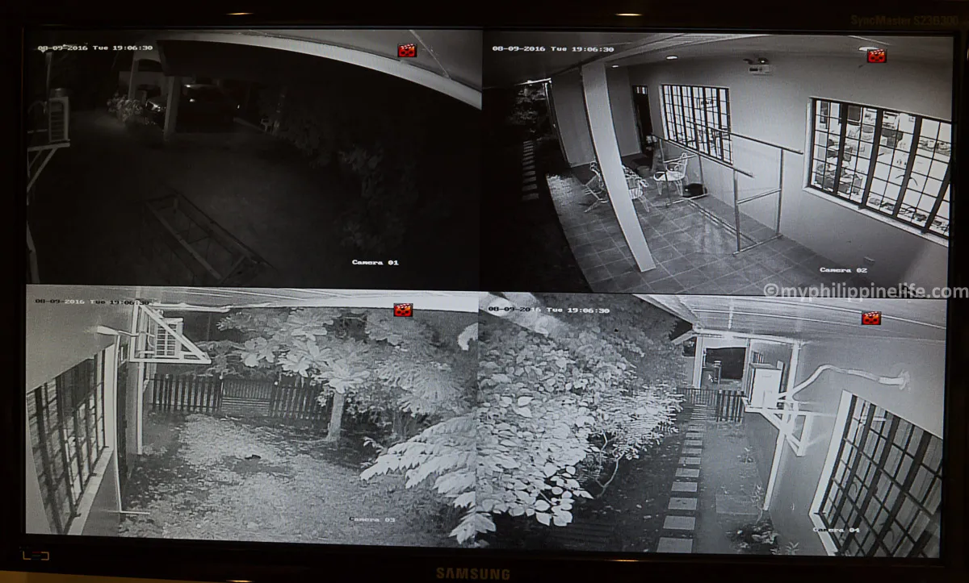
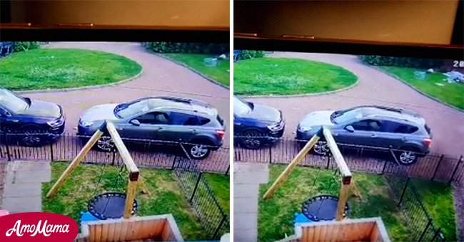
Log out

Slide 32
GRAND RIVERSIDE SUBDIVISION
Create your post
My profile
Organizations
Juan Manalo
Apr 28 at 12 am
CCTV
Someone lost his bike at 5 pm
Rules and Regulations
Log out

Slide 33






RULES AND REGULATION
Subdivision Regulation
SANITATION
Always observe cleanliness and practice proper waste disposal
SILENCE
Be mindful of others by keeping the noise down.
PETS
Practice responsibility with your pets when it comes to noise and sanitation
PROPERTY LIMITS
Respect each other’s privacy and space.
Log out

Slide 34
Create your post
Juan Manalo
Apr 28 at 12 am
Someone lost his bike at 5 pm
Log out

Slide 35

NOTIFICATIONS
Anna Palma posted in KILAY
2 new events added in HOA
Julian Carlo posted in SAMAHAN NG MGA KABATAAN
There are new posts in KILAY
Log out

Slide 36

MARKETPLACE
Categories
Foods
Items of clothing
School Supplies
Pharmacy
Salon/Barber shop
Log out

Slide 37

Juan Luna
set status
Edit Profile
Contact
Email
juan_luna@yahoo.com
Phone number
09647363735
Log out

